Slide 1
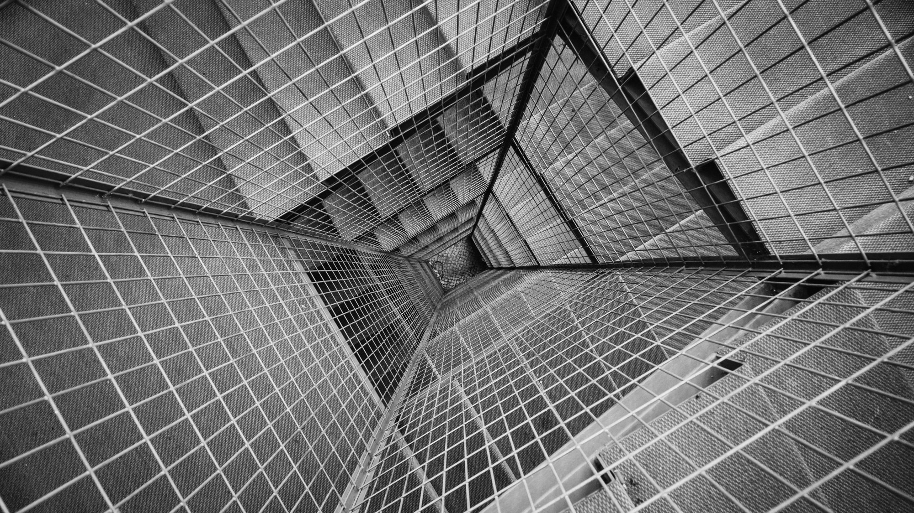
WEBSITE
PROJECT
By: Joan L. Matuto

Slide 2

HCI PROJECT DAY 1
FOOD BLOG

Slide 3
PURPOSE AND AUDIENCE
PURPOSE
AUDIENCE
The purpose of this website is to create a field where people can communicate about the places they are interested to go and foods they wanted to make.
My audience are all those who are needing a website who can give ideas and recommendations about certain place to eat and foods to make.

Slide 4
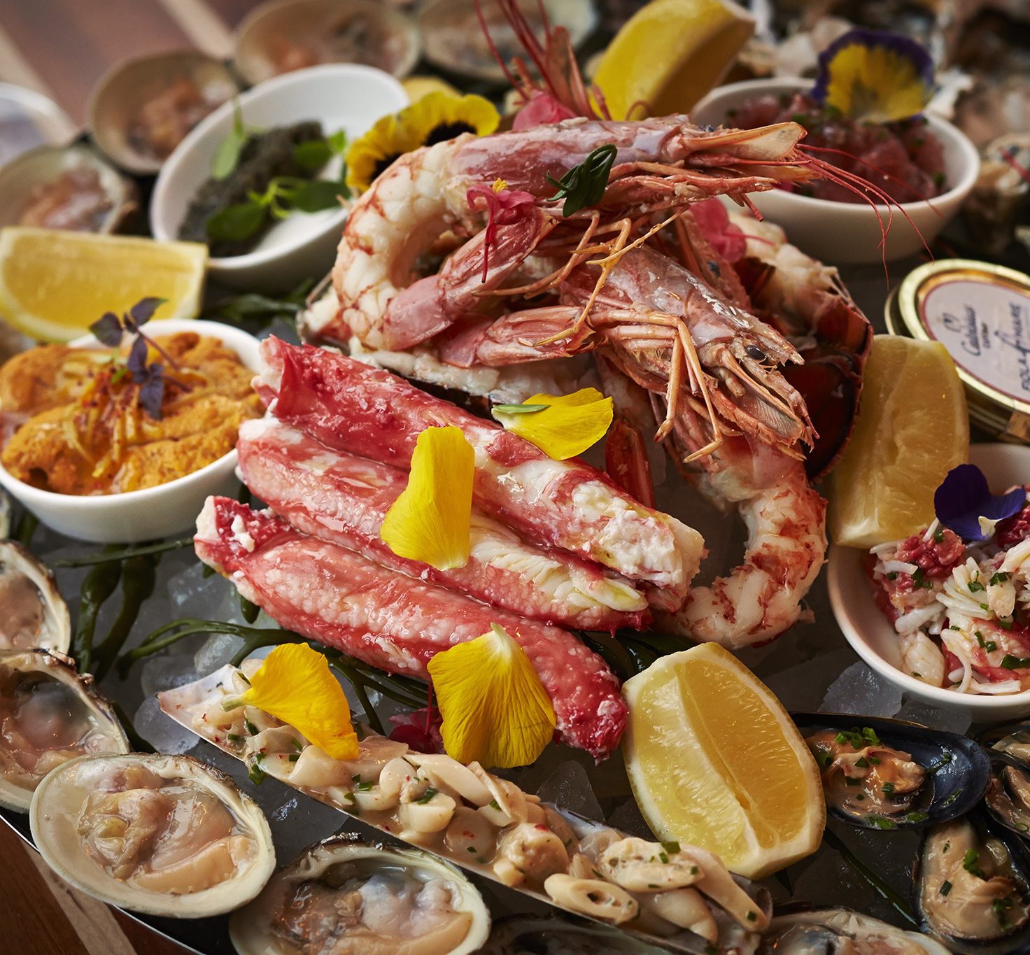
What Information do I want to present?
This website includes information about restaurant reviews, recipes, references and cooking tips.

Slide 5
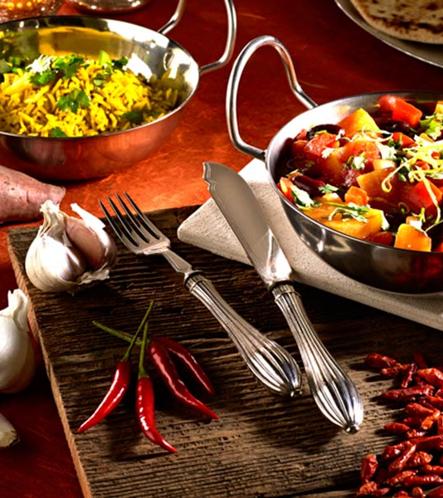
What is my vision about this website?
My vision about this website is that it may grow, be recognized and develop through time.

Slide 6
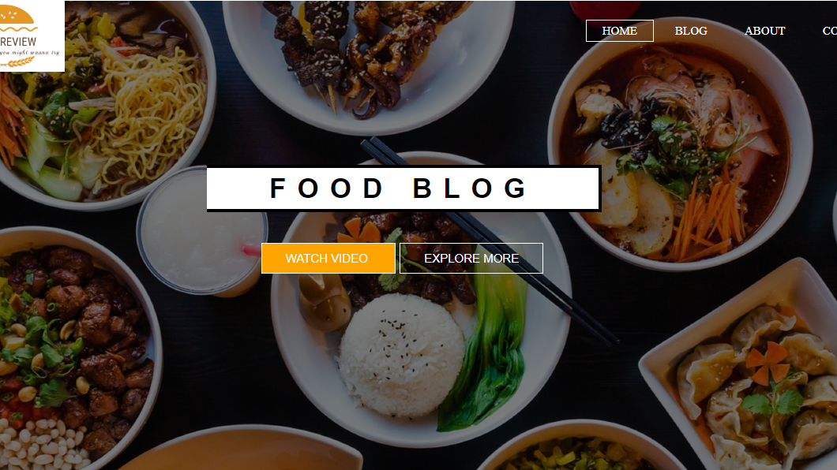
Large Picture Slide
MOCK HOMEPAGE OF MY WEBSITE

Slide 7

THANK YOU
https://github.com/lunoxxx

